Slide 1
ART GALLERY MANAGEMENT
Group 05

Slide 2
Members:
Shaneen Shadman Khandakar (19101176) – System Request, Business Requirements, Use Case, Activity Diagram, Windows Navigation Diagram, Slide, Report.
Ahmad Al Asad (19101196) – System Request, Business Requirements, Use Case, Activity Diagram, Sequence Diagram, Data Flow Diagram, Windows Navigation Diagram, Implementation, Slide, Report.
Fardin Junayed Karim (19101198) – System Request, Business Requirements, Use Case Diagram, Activity Diagram, Sequence Diagram, Slide.

Slide 3
Planning
The purpose of this project is for all those art enthusiasts scattered around the world, who want to appreciate art even on their busy schedule, hence building an online platform for bringing them all together. All types of art deals and auctions are done through this website. This creates an entire virtual ecosystem for all types of art genres. Thus, our vast inventory will provide the feelings of an art exhibition, one will get when visiting an art gallery. And finally, our management will ensure all the transactions being made are done fluidly without any hassle.

Slide 4
Analysis
Mainly dedicated for art enthusiasts all over the world, this will be a well-functioned website that will work on Android, iOS, tablet, PC, etc. As our project sponsor, Laurence des Cars, president-director of the Louvre Museum, has given us the opportunity to build this project, we firmly believe this project will make sure all your art dreams will come true. A 24/7 online platform service will ensure the best art offers and compositions one can imagine. We believe that this will be a huge groundbreaking deal in the world of art.

Slide 5
Design
There will be a home page for showcasing popular arts, and that page will have redirects to the Showcase page which will be a virtual art gallery.
Guest visitors can view all the arts and browse, but purchasing requires an account login and payment information.
There will be a bidding system for buying arts only for verified users
The arts will be categorized and customers can search for different arts based on their artist, title, type of art and year.
Customers can also search for artists using their name, birthplace, age and style of art.
There will be an admin panel, only accessible to admins, which will show the list of art pieces set for showcasing, auction, and those that have been sold, best-selling artists, customers’ expenditures etc.
There will be another panel exclusive to the artists, and their agents, where they can see the bid on their art pieces, arts that have been sold and other information.

Slide 6
Analysis of current system
Buying licenses from artists and copyright owners before showcasing their arts in their gallery.
Getting government approval and solving mandatory tax issues for inter-country delivery.
Management will contain a team of art connoisseurs for conducting fraudulent checks on new arts before putting them for showcasing.
Management will ensure that the art being showcased must not exhibit/prioritize discrimination or any racial slurs.
For online transactions, authorisation from bank authorities is required.

Slide 7
Analysis of Proposed System
Tangible Value:
Having many renowned artists’ masterpieces on one website will increase traffic, hence will result in a 35% increase in sales from new customers.
Introducing premium services would increase sales by 15% among existing customers as buying more is encouraged by giving exclusive rewards and vouchers to the customers.
Business partners give a 10% discount when their services are used for product delivery.
Intangible Value:
Having a virtual platform is what everyone wants in this era of the 4th Industrial Revolution so that people can save their time by browsing through a website or an app to look for the aesthetics they desire.
Having online auctions will increase customer satisfaction as they can stay anonymous from other customers, this will, in turn, improve customer privacy and security.

Slide 8
Use Case Diagram

Slide 9
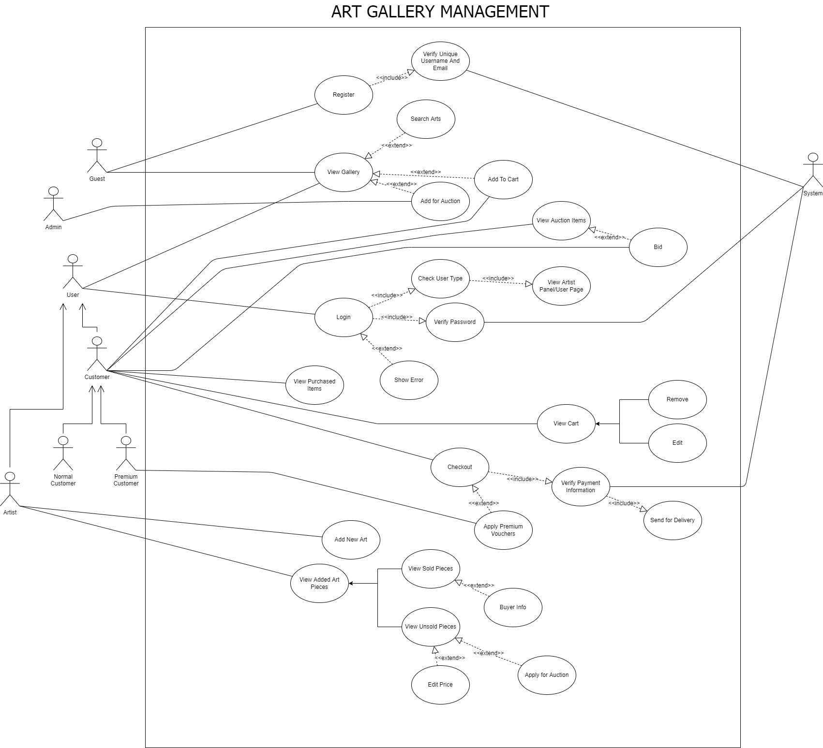

Slide 10
Activity Diagram

Slide 11
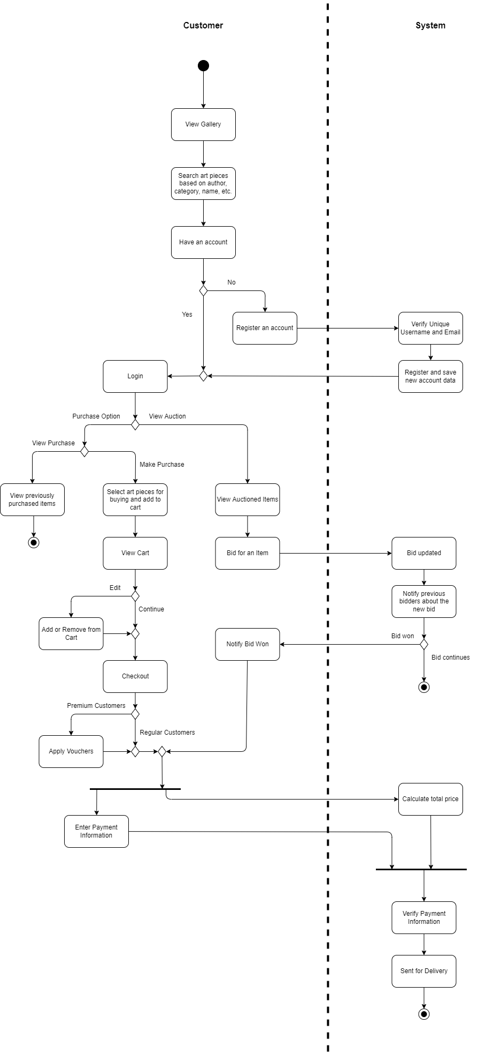
Customer Side

Slide 12
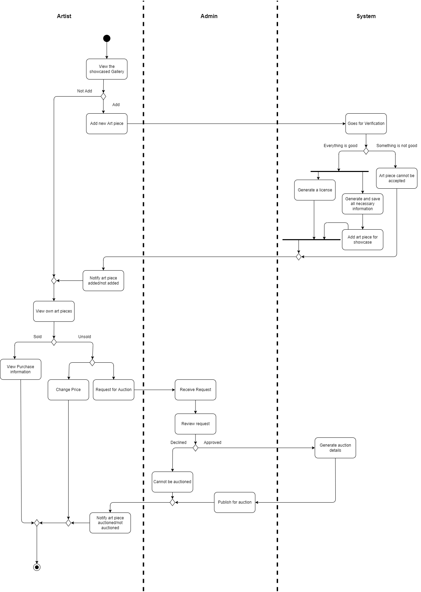
Artist Side

Slide 13
Data Flow Diagram

Slide 14
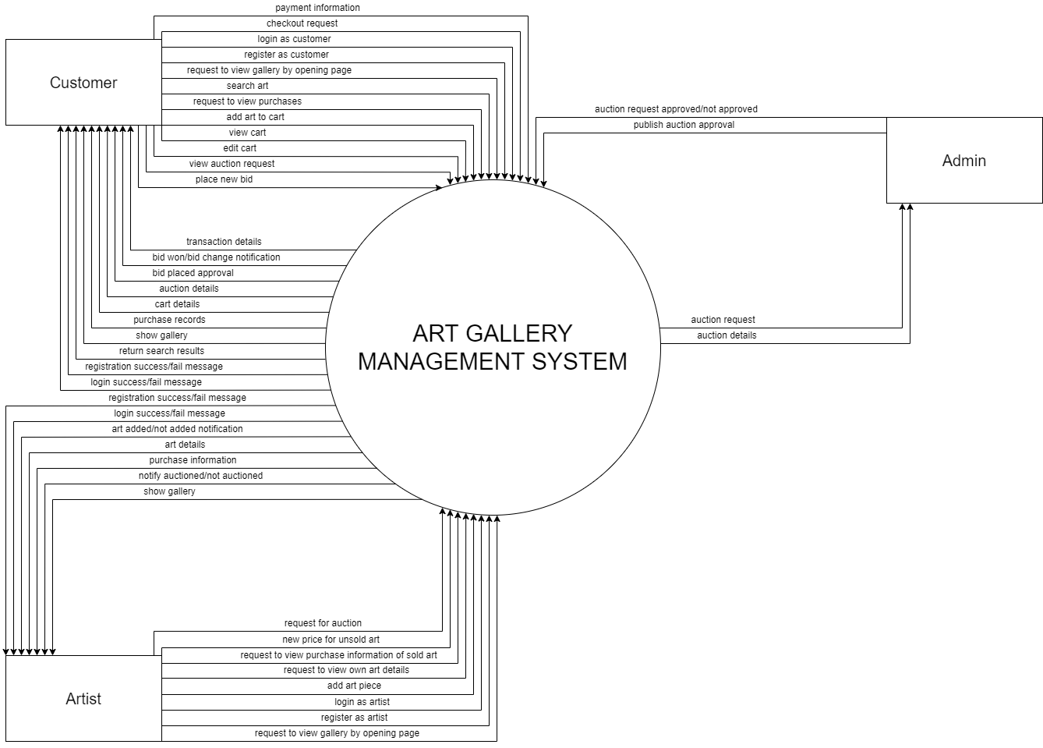
Level 0

Slide 15
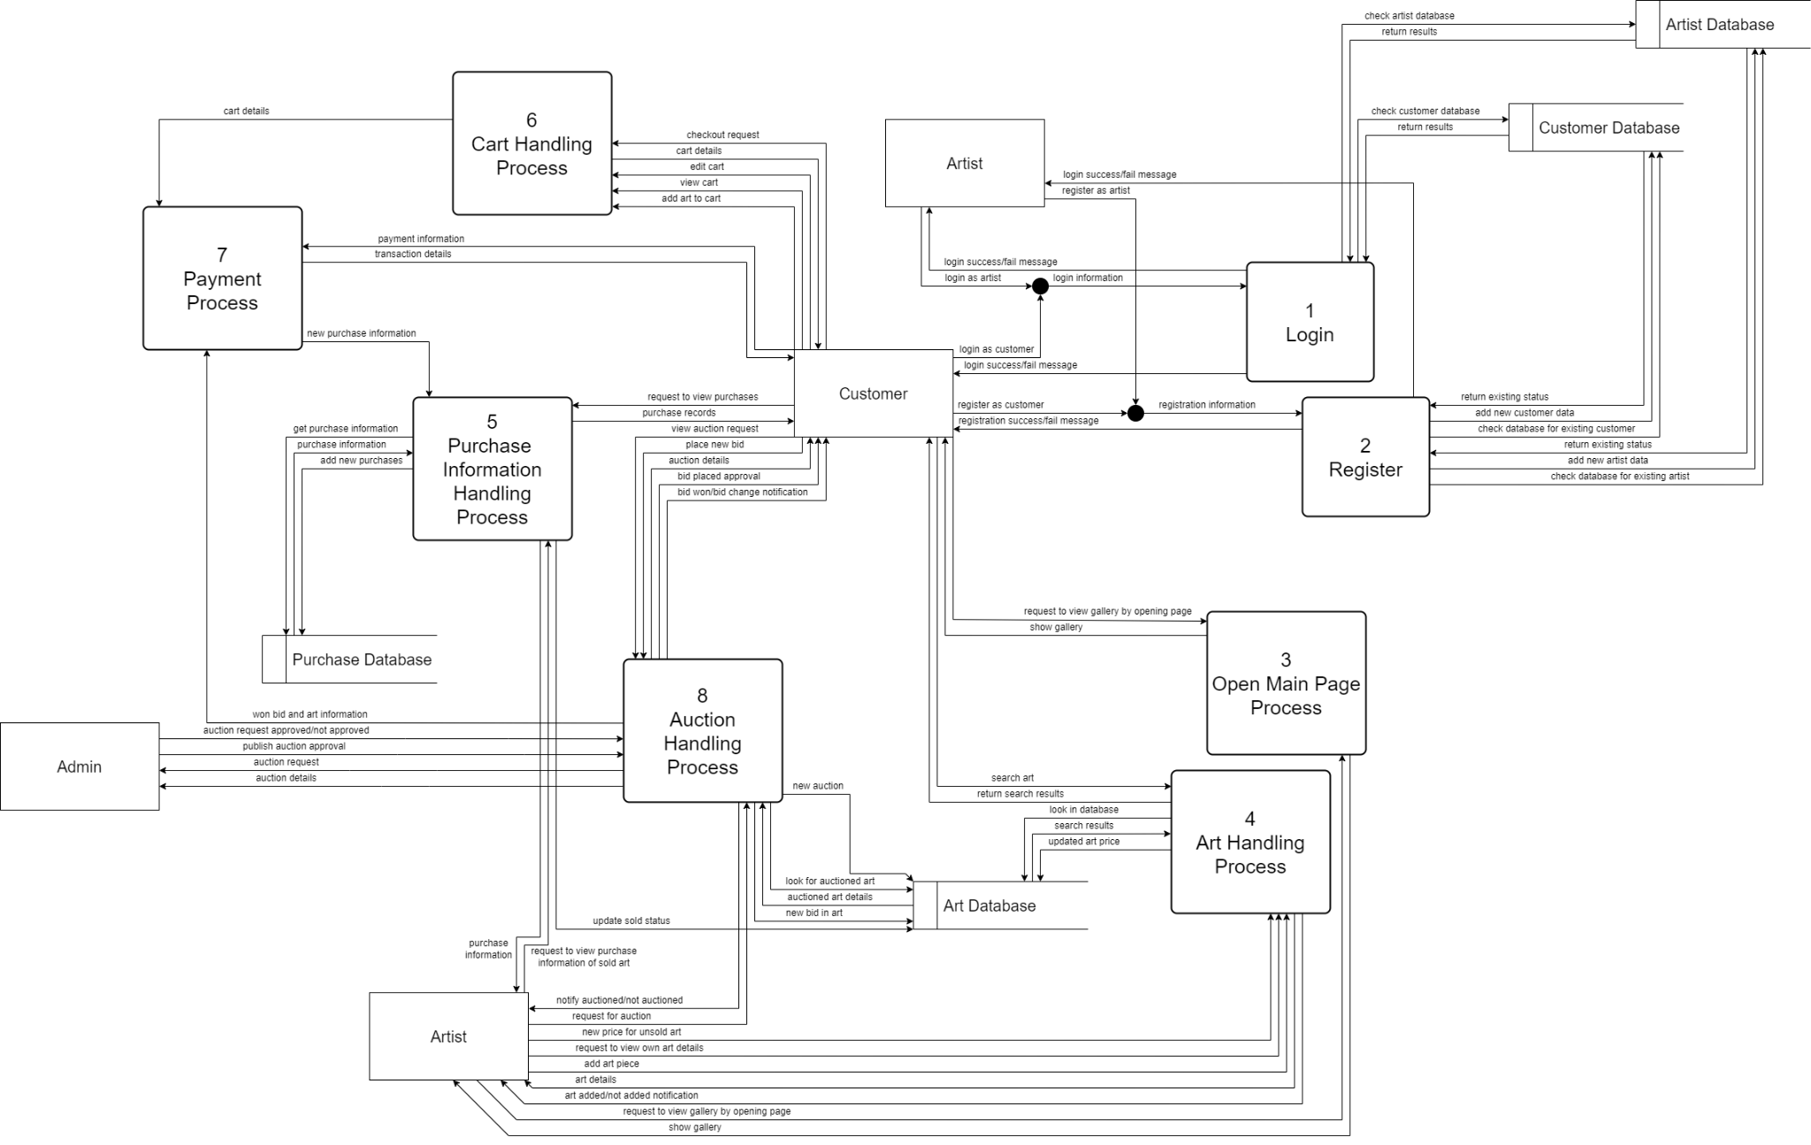
Level 1

Slide 16
Summary and Conclusion
Our Art Gallery aims to satisfy the wants of art lovers all across the globe. Availability of art pieces from numerous genres is sure to excite collectors and art enthusiasts of different tastes and preferences. Online services will be open 24/7, meaning people from varying time zones can access the website at their convenient times. Worldwide delivery allows art pieces that are either bought from the catalogue or won in the auction, to be sent directly to the doorsteps of our customers. We have also provided an amazing platform for artists, both new and old, to add their artworks in our gallery, enabling them to showcase their talent and skills in a global stage. Overall, we believe this project will bring people, who share the love of art, together and let us celebrate the beauty and creativity that is expressed through artworks.

